Slide 1
8086/8088 Instruction Set, Machine Codes and Addressing Modes

Slide 2
Software
The sequence of commands used to tell a microcomputer what to do is called a program,
Each command in a program is called an instruction
8088 understands and performs operations for 117 basic instructions
A program written in machine language is referred to as machine code
In 8088 assembly language, each of the operations is described by alphanumeric symbols instead of 0-1s.
ADD AX, BX
(Opcode) (Destination operand) (Source operand )

Slide 3
Two key benefits of assembly language programming
  – It takes up less memory
  – It executes much faster

Slide 4
Applications
One of the most beneficial uses of assembly language programming is real-time applications.
Real time means the task required by the application must be completed before any other input to the program that will alter its operation can occur
For example the device service routine which controls the operation of the floppy disk drive is a good example that is usually written in assembly language

Slide 5
Assembly language not only good for controlling hardware devices but also performing pure software operations
  – Searching through a large table of data for a special string of characters
  – Code translation from ASCII to EBCDIC
  – Table sort routines
  – Mathematical routines
Assembly language: perform real-time operations
High-level languages: used to write those parts that are not time critical

Slide 6

Converting Assembly Language Instructions to Machine Code
An instruction can be coded with 1 to 6 bytes
Byte 1 contains three kinds of information
  – Opcode field (6 bits) specifies the operation (add, subtract, move)
  – Register Direction Bit (D bit) Tells the register operand in REG field in byte 2 is source or destination operand
  1: destination 0: source
  -Data Size Bit (W bit) Specifies whether the operation will be performed on 8-bit or 16-bit data
  0: 8 bits 1: 16 bits

Slide 7
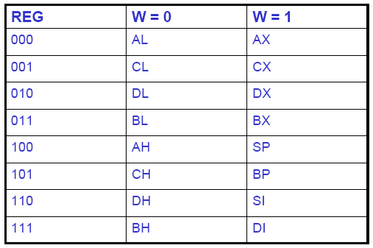
Byte 2 has three fields
– Mode field (MOD)
– Register field (REG) used to identify the register for the Source operand
– Register/memory field (R/M field) used to identify the Destination operand
MOD contains 2 bits
REG contains 3 bits
R/M contains 3 bits

Slide 8
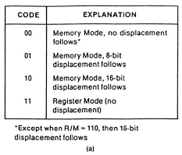
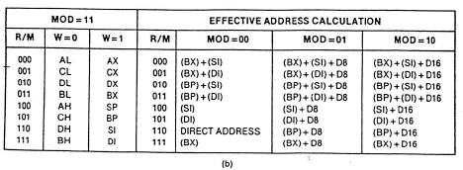
2-bit MOD field and 3-bit R/M field together specify the second operand
Mode Field encoding
Register/memory (R/M) Field Encoding

Slide 9
Examples
MOV BL,AL (88C3₁₆)
Opcode for MOV = 100010
D = 0 (AL source operand)
W bit = 0 (8-bits)
Therefore byte 1 is 10001000₂=88₁₆
• MOD = 11 (register mode)
• REG = 000 (code for AL)
• R/M = 011 (destination is BL)
Therefore Byte 2 is 11000011₂=C3₁₆

Slide 11
Examples:
MOV BL, AL = 10001000 11000011 = 88 C3h
ADD AX, [SI] = 00000011 00000100 = 03 04 h
ADD [BX] [DI] + 1234h, AX = 00000001 10000001 __ __ h = 01 81 34 12 h

Slide 12
8086 Microprocessor Register
8086 Registers Category
Category | Bit | Register Name
General Purpose Register | 16 | AX,BX,CX,DX
General Purpose Register | 8 | AH,AL,BH,BL,CH,CL,DH,DL
Pointer Register | 16 | SP (Stack Pointer) BP (Base Pointer)
Index Register | 16 | SI (Source Index) DI (Destination Index)
Segment Register | 16 | CS (Code Segment) DS (Data Segment) SS (Stack Segment) ES (Extra Segment)
Instruction Pointer Register | 16 | IP (Instruction Pointer)
Status Register (Flag) | 16 | DR (Flag Register)

Slide 13
Addressing Modes
Addressing Mode is a technique to determine which operand is to be fetched. (Operand = argument for an operator or for machine language instruction)
Addressing mode is used for:
  Give flexible programming to user using pointers to memory, counter for loop control, index for data and program replacement
  There are 7 types of addressing mode in 8086 register:
  Register addressing mode
  Immediate addressing mode
  Direct addressing mode
  Indirect addressing mode
  Base relative addressing mode
  Index relative addressing mode
  Base index relative addressing mode

Slide 14
Register Addressing Mode
Simplest mode and often used
Involved register usage
Data obtained from operation is stored in other register
EA = R
EA = Effective Address (EA) for one location which contain reference operand
R = Address field content in instruction which refer to register (R)

Slide 15
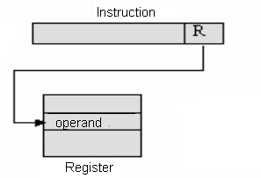
Register Addressing Mode
Figure: Register Addressing Mode (EA=R)

Slide 16
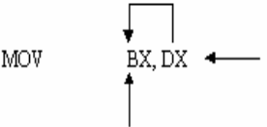
Register Addressing Mode
Example:
Copy DX value to BX
Source operand
Destination operand

Slide 17
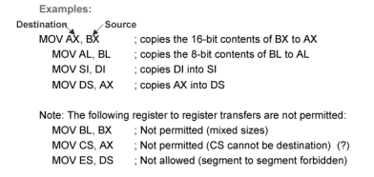
Register Addressing Mode

Slide 18


Immediate Addressing Mode
Data is coded directly into machine code instruction
Operand for source is a constant and is part of instruction
Operand = A (where A = content for address field in instruction
Figure: Immediate Addressing Mode (Operand = A)
Example:
Load value 2550H to AX
Source operand
Destination operand

Slide 19


Immediate Addressing Mode
Can’t be used with data segment (DS) and flag register (DF)
This problem can be overcome by loading 0123H to one general purpose register and then the register value is copied to segment register as the following:
Invalid Example:
Load value directly to DS
Source operand
Destination operand

Slide 20
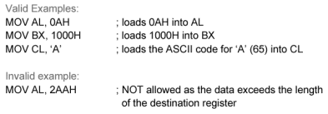
Immediate Addressing Mode

Slide 21
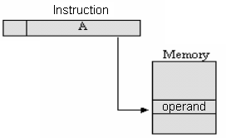
Direct Addressing Mode
Operand is stored in memory location, commonly data segment (DS)
Source operand is the address not immediate data (written in [ ])
This address is effective address which is the address of 16-bit offset for operand storage location (from current DS value)
Effective address need to be coupled with DS content to get the true operand address (physical address)
EA = A
EA = Effective address for
location that contains
referred operand
A = Content for address field in
one instruction

Slide 22

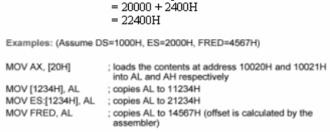
Direct Addressing Mode
Example
Effective Address given is = 2400. If DS content is 2000 therefore physical address is
Physical Address = Segment Address + Effective Address

Slide 23
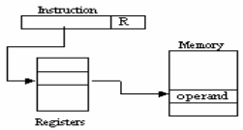

Indirect Addressing Mode
This mode use register as substitute to constant (in direct addressing mode) to determine 16-bit offset address for an operand
Offset address where data is placed might be in base pointer register (BP), base register (BX), index register (DI,SI)
In ambiguity case, assembler use BYTE PTR and WORD PTR to show the size of data address using memory pointer
R= content for address
field in instruction
which referred to
register

Slide 24
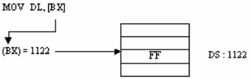

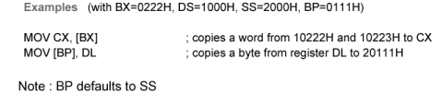
Indirect Addressing Mode
It is often used to access data table from memory
Example:
Effective Address given is = 1122. If DS content is 1010 therefore physical address is
Physical Address = Segment Address + Effective Address

Slide 25
Base Relative Addressing Mode
Operand located in address obtained from addition of 8 or 16 bit displacement into one of BX or BP and the result is then combined with segment data (DS/SS)
This 8 or 16- bit displacement must be specified in operand field and translated as signed two’s compliment
For 8-bit, displacement must in the range of -128 to +127
For 16-bit, displacement must in the range of -32768 to +32767
Effective Address = [Base register] + displacement
Physical Address = DS/SS = [Base register] + displacement

Slide 26


Base Relative Addressing Mode
Example:
Effective Address = Register [BX] + displacement
If DS content is 4000 therefore physical address is:
Physical Address = Segment Address + Effective Address

Slide 27
Indexed Relative Addressing Mode
The same as base addressing except that index register (SI/DI) is used
Operand is at given address by signed 8 or 16-bit displacement addition to one of SI or DI and the result is then added with segment register (DS=Default)
Example
MOV DX, ARRAY [SI]
Effective address = register [SI] + ARRAY
= 5000 + 1234H
= 6234H
If DS content is 2000, therefore the physical address is
Physical address = Segment address + Effective address
= 20000H + 6234H
=26234H

Slide 28

Indexed Relative Addressing Mode

Slide 29


Base Indexed Relative Addressing Mode
Combine base addressing mode and indexed addressing mode
Base register (BX?BP) is added to index register (DI/SI) as positive integer (each register is in the range of 0 to 65535)
As default, segment address is obtained from DS except for BP register which is obtained form SS
Effective Address = [base address] + [index register] + displacement
Example
Let say BX = 1000X, SI = 2000H, BETA = 1234H, DS =1200H
Effective Address = register [BX] + register [SI] + ARRAY
Physical Address = Segment address + Effective address

Slide 30
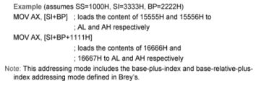
Base Indexed Relative Addressing Mode

Slide 31
Conclusion
Addressing Mode | Advantage | Disadvantage
Register | No memory reference | Limited address space
Immediate | No memory reference | Limited operand magnitude
Direct | Easy | Limited address space
Indirect | Large address space | More reference to memory
Base relative | Flexible | Complex
Index relative | Flexible | Complex
Base index relative | Flexible | Complex

